Slide 1

Coursework II – Handwritten Digits
February 2024

Slide 2
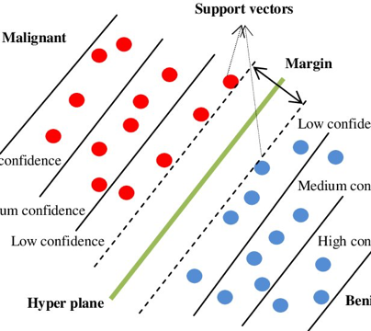
Classification using Support Vector Machine
SVM starts by plotting all the data points on a hyperplane.
Support Vectors are those data points that lie closest to the line separating each class cluster.
The SVM classifier has to classify these points to their particular class with maximum accuracy.
The distance between the Support Vectors and the decision boundary is called the Margin.
The major task of any SVM classifier is to divide the data points is such manner that the Margin is maximum in value.

Slide 3
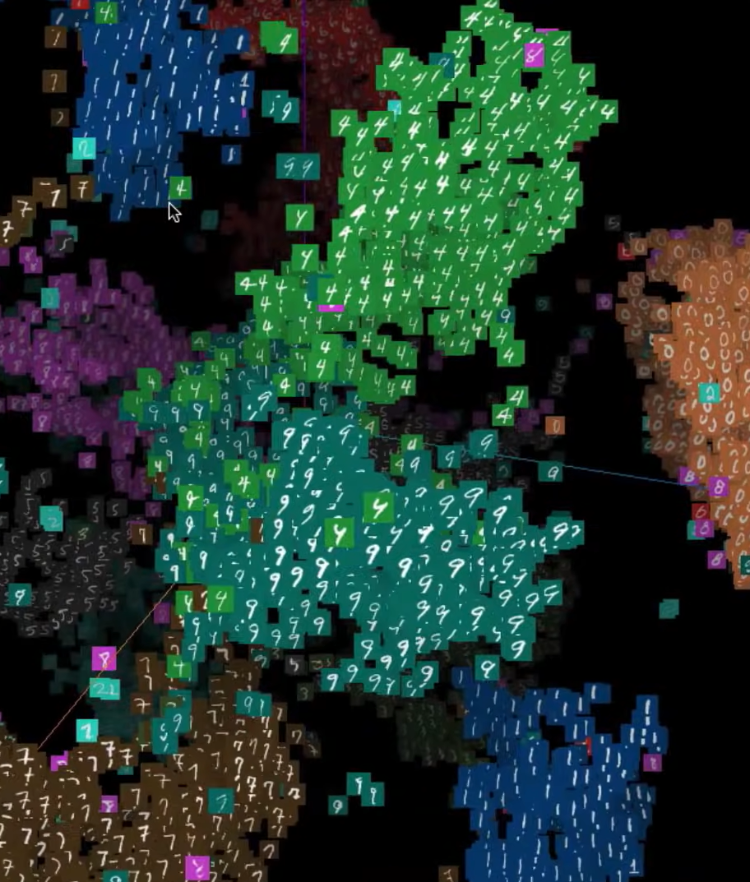
Multi Class Classification
Algorithms such as the Perceptron, Logistic Regression, and Support Vector Machines were designed for binary classification and do not natively support classification tasks with more than two classes.
How to use binary classification algorithms for multi-classification problems?
Split the multi-class classification dataset into multiple binary classification datasets and fit a binary classification model on each.
Two different examples of this approach are the One-vs-Rest and One-vs-One strategies.
The One-vs-Rest strategy splits a multi-class classification into one binary classification problem per class.
The One-vs-One strategy splits a multi-class classification into one binary classification problem per each pair of classes.
https://projector.tensorflow.org/

Slide 4

Tuning Parameters - Kernel
Radial Basis Function or Gaussian Kernel
A kernel is a function that returns the result of a dot product performed in another space.
A kernel is a measure of the similarity between two vectors
A RBF is a function whose value depends only on the distance from the origin or from some point.
The RBF kernel returns the result of a dot product performed in

Slide 5
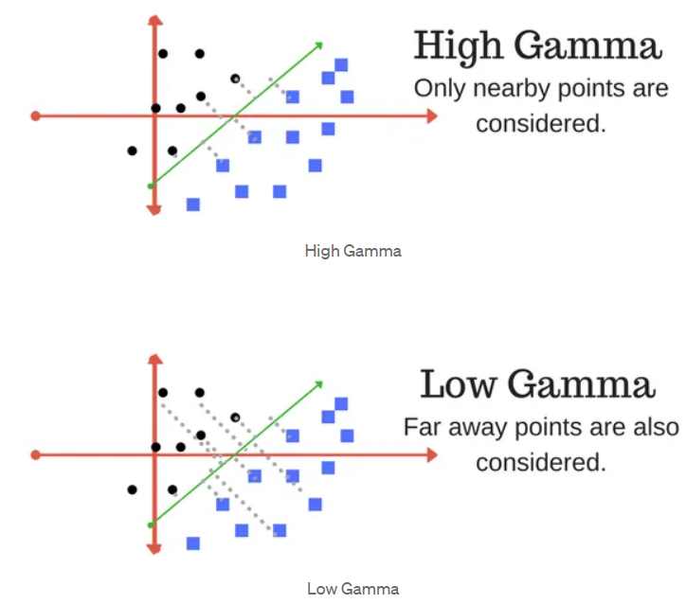
Tuning Parameters - Gamma
The gamma parameter defines how far the influence of a single training example reaches, with low values meaning ‘far’ and high values meaning ‘close’.
With low gamma, points far away from plausible separation line are considered in calculation for the separation line.
High gamma means the points close to plausible line are considered in calculation.
Gamma = 0.5

Slide 6
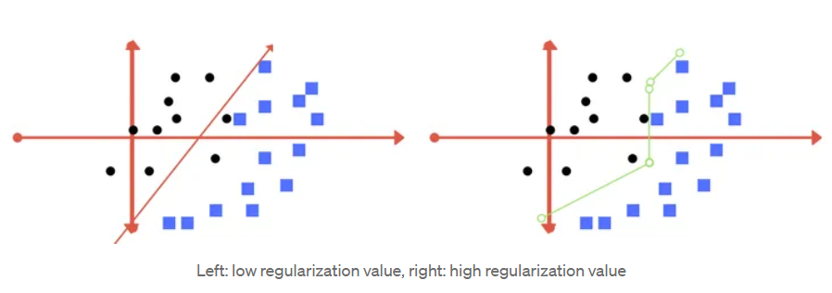
Tuning Parameters - Regularization
The Regularization parameter (often termed as C parameter in python’s sklearn library) tells the SVM optimization how much you want to avoid misclassifying each training example.
For large values of C, the optimization will choose a smaller-margin hyperplane if that hyperplane does a better job of getting all the training points classified correctly.
Conversely, a very small value of C will cause the optimizer to look for a larger-margin separating hyperplane, even if that hyperplane misclassifies more points.
C = 0.01

Slide 7
Main Function
Read Train Dataset
Read Test Dataset
Build 10 SVMs
Train for 10 classes
Calculate accuracies for train and test

Slide 8
Constructor for SVM
/**
* @param name_ name of SVM
* @param data_ training dataset
* @param dataClass_ expected values of training dataset
* @param C_ regularization hyperparameter
* @param gamma_ hyperparameter for RBF
* @param positiveData_ integer that will be considered positive output
*/

Slide 9
trainModel()
1. **Initialization:**
- Initialize variables:
- `numChanged` to 0, which keeps track of the number of alphas changed during the iteration.
- `examineAll` to `true`, indicating that the algorithm will start by examining all data points.
- `iterations` to 0, representing the current iteration count.
- Enter a loop that continues until either the maximum number of iterations (`MAX_ITERATIONS`) is reached or no alphas are changed, and `examineAll` is `false`.
2. **Iteration:**
- Print the current iteration number for monitoring purposes.
- Set `numChanged` to 0 at the beginning of each iteration.
3. **Optimization Loop:**
- Depending on the value of `examineAll`, iterate through all data points (`numSamples`) or only those with alphas within the (0, C) range.
- For each data point, call the `optimizeAlpha` method to attempt to optimize the Lagrange multiplier (`alpha`). The method returns 1 if an optimization occurs and 0 otherwise.
- Update `numChanged` by adding the returned value from `optimizeAlpha`.
4. **Update `examineAll`:**
- Update the value of `examineAll` based on the results of the iteration:
- If `examineAll` was `true` and `numChanged` is greater than 0, set `examineAll` to `false`.
- If `examineAll` was `false` and `numChanged` is 0, set `examineAll` to `true`.
5. **Increment Iteration Count:**
- Increment the `iterations` counter.
6. **Loop Termination:**
- Continue the loop until either the maximum number of iterations is reached or no alphas are changed, and `examineAll` is `false`.
Notes:
In summary, the `train` method performs multiple iterations of the SMO algorithm to train an SVM. It alternates between examining all data points and examining only a subset of them, updating the Lagrange multipliers, and adjusting the examination strategy based on the optimization results. The loop terminates when a specified maximum number of iterations is reached or no further changes are observed.

Slide 10
Optimizing the values of the Lagrange multipliers (alphas) for a pair of data points in order to update the SVM model.
1. **Initialization:**
- `y1` is the label of the first data point.
- `alpha1` is the Lagrange multiplier (weight) associated with the first data point.
- `E1` is the error of the SVM prediction for the first data point.
2. **Check Conditions:**
- Checks whether the current Lagrange multiplier `alpha1` violates the KKT (Karush-Kuhn-Tucker) conditions, which are necessary for the solution of the SVM optimization problem.
- If conditions are not met, the method returns 0, indicating that no optimization is performed.
3. **Choose a Second Data Point:**
- `i2` is chosen randomly, and its label (`y2`), Lagrange multiplier (`alpha2`), and error (`E2`) are obtained.
4. **Compute Bounds (`L` and `H`):**
- Computes the lower bound (`L`) and upper bound (`H`) for the new Lagrange multiplier (`alpha2`) based on the SVM optimization problem constraints.
5. **Compute Kernel Values:**
- Computes the kernel values `k11`, `k22`, and `k12` using the radial basis function (RBF) kernel for the chosen data points.
6. **Update Lagrange Multipliers:**
- Updates the Lagrange multiplier `alpha2` based on the chosen optimization strategy.
- Handles cases where the new value of `alpha2` is outside the computed bounds.
7. **Check Convergence:**
- Checks for convergence based on a tolerance condition. If the change in `alpha2` is small, no further optimization is performed.
8. **Update Bias (`b`):**
- Computes the bias term (`b`) based on the updated Lagrange multipliers.
- If either `a1` or `a2` is within the (0, C) range (C is a regularization parameter), `b` is set to the corresponding value (`b1` or `b2`). Otherwise, it is set to the average.
9. **Update Lagrange Multipliers in the Array (`alphas`):**
- Updates the Lagrange multipliers for the chosen data points in the array `alphas`.
10. **Return Status:**
- Returns 1 to indicate that the optimization was successful.
11. **Fallback:**
- If the initial conditions are not met, the method returns 0, indicating that no optimization was performed.
Notes:
The optimization aims to find the optimal values for the Lagrange multipliers, considering the SVM constraints and kernel values. The optimization of Lagrange multipliers in SVMs is necessary for constructing an effective decision boundary, maximizing the margin between classes, handling non-linear transformations through the kernel trick, and satisfying the KKT conditions for optimality. This process contributes to the robustness and generalization capability of the SVM model.

Slide 11
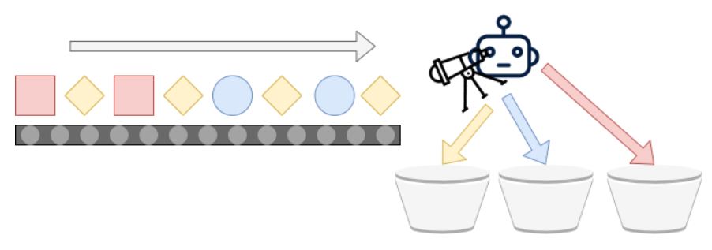
Other useful helper methods
Choose a random index
rbfKernel implementer – calculates the dot product of x1 and x2 in infinite dimensions
Calculate error in the value of alpha
Classify to calculate whether a datapoint lies with respect to a hyperplane
Calculate the value of the quadratic problem to optimise for alpha

